Slide 1

Data Analysis: MULTILINGUAL TV SHOWS

Slide 2

Project Description
The dataset is a comprehensive collection of TV shows across various languages, genres, and types, featuring viewer ratings and average run times.
Explore the diversity of global television programming and uncover insights into audience preferences, programming trends, and more!"

Slide 3
Questions
What are the top-rated TV shows by genre and language?
Which type of TV show (e.g., drama, comedy, reality TV) has the highest average viewer rating?
How do viewer ratings vary by language?
What is the average run time for different types of TV shows?
Are there any correlations between viewer ratings and run times?

Slide 4
Data Design
To provide solutions to the questions highlighted in the previous slide.
The dataset was critically studied in line with the headers provided; TV-shows type, the assumed run time, seasons and episodes, and viewers’ ratings in line with industry practice
The original data was cleaned using, Microsoft Excel, Power BI, and Python for data relevance and usability
The cleaned dataset obtained from MS Excel was largely used for the visualization.
while the dashboard was the output from Power BI data cleaning and analysis

Slide 5

Findings and Insights

Slide 6
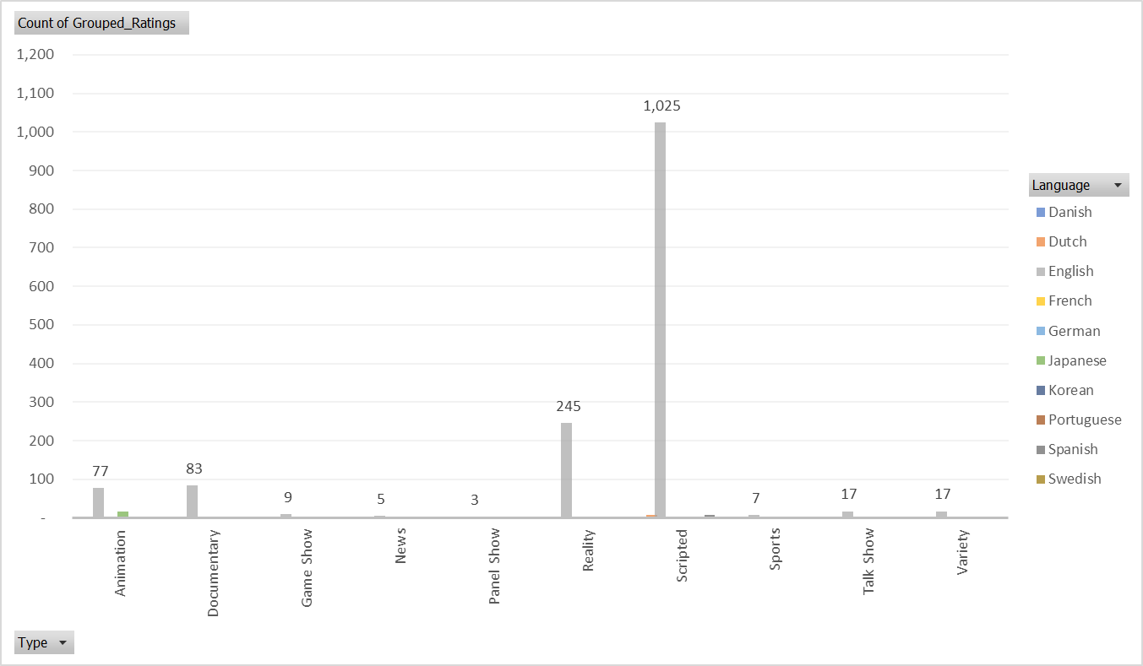

Solution 1: Top-rated TV shows by Show Type and language
Key Findings:
1. English dominates the overall ratings (1488), followed by Japanese (245) and Spanish (17).
2. Scripted genre leads in English (1025), while Reality tops Japanese (245).
3. Animation is prominent in Danish (77) and English (94).
4. Documentary is notable in Dutch (83) and English (85).
5. Game Show and Talk Show are exclusively English (9 and 17, respectively).
Insights:
- English-language TV shows dominate overall ratings, with Scripted and Animation genres being the most popular.
- Japanese TV shows have a significant presence, primarily in the Reality genre.
- Other languages have niche audiences, with Danish and Dutch preferring Animation and Documentary, respectively.

Slide 7
Solution 1: Summary
Produce more Scripted and Animation content in English to cater to the dominant audience.
Explore opportunities in Japanese Reality TV and Danish/Dutch Animation.
Consider diversifying content in other languages to tap into niche audiences.
This summary provides a snapshot of the top-rated TV shows by genre and language, highlighting key trends, insights, and recommendations for future content development

Slide 8
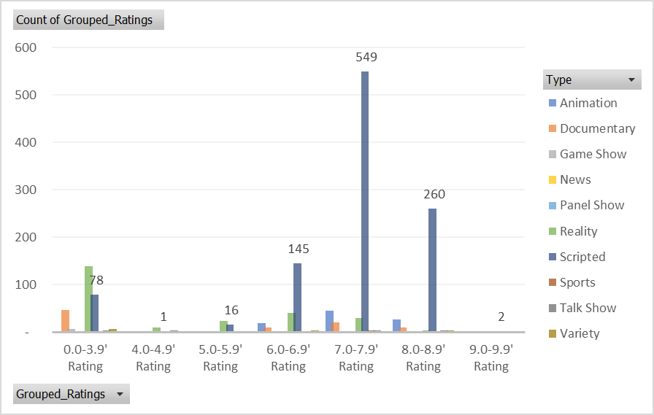

Solution 2: Highest Viewers Rating
Key Findings:
1. Scripted TV shows have the highest average viewer rating, with 1051 ratings in the 7.0-7.9 range and 260 ratings in the 8.0-8.9 range.
2. Reality TV shows follow closely, with 245 ratings in the 7.0-7.9 range and 40 ratings in the 6.0-6.9 range.
3. Animation and Documentary TV shows have lower average viewer ratings, with most ratings in the 6.0-6.9 and 5.0-5.9 ranges, respectively.
Insights:
- Scripted TV shows are the most popular among viewers, with a significant lead in high ratings (7.0-7.9 and 8.0-8.9).
- Reality TV shows are the second most popular, with a notable presence in high ratings (7.0-7.9 and 6.0-6.9).
- Animation and Documentary TV shows have niche audiences, with lower average viewer ratings.

Slide 9
Solution 2: Summary
Produce more Scripted content to cater to the dominant audience.
Explore opportunities in Reality TV to tap into the second-largest audience.
Consider diversifying content in Animation and Documentary genres to attract niche audiences.
This summary provides a snapshot of the TV show type with the highest average viewer rating, highlighting key trends, insights, and recommendations for future content development.

Slide 10
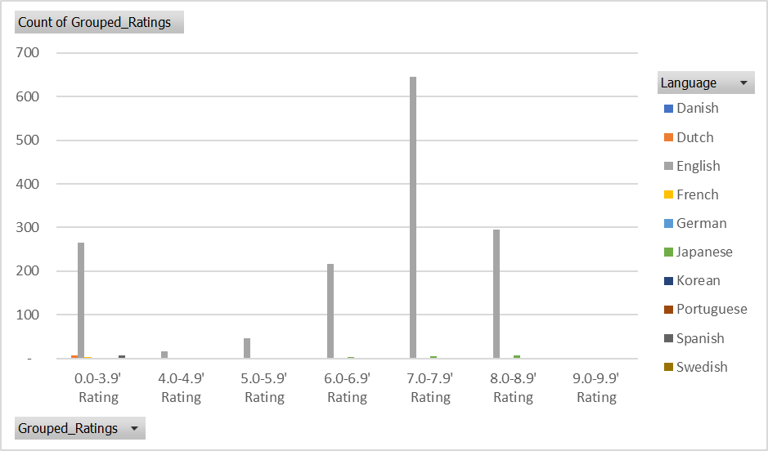
Solution 3: Viewers rating variation by language
Key Findings:
1. English has the highest viewer ratings, with 1488 ratings in the 7.0-7.9 range and 296 ratings in the 8.0-8.9 range.
2. Japanese follows, with 217 ratings in the 6.0-6.9 range and 1 rating in the 7.0-7.9 range.
3. German and French have lower viewer ratings, with most ratings in the 4.0-4.9 and 5.0-5.9 ranges, respectively.
4. Danish, Dutch, Korean, Portuguese, and Spanish have minimal viewer ratings, mostly in the 0.0-3.9 range.
5. Swedish has only 2 ratings, both in the 9.0-9.9 range.
Insights:
- English-language TV shows dominate viewer ratings, with a significant lead in high ratings (7.0-7.9 and 8.0-8.9).
- Japanese TV shows have a notable presence with high ratings (6.0-6.9 and 7.0-7.9).
- German and French TV shows have lower viewer ratings, while other languages have minimal ratings.

Slide 11

Solution 3: Summary
Produce more English-language content to cater to the dominant audience.
Explore opportunities in Japanese content to tap into the second-largest audience.
Consider diversifying content in other languages to attract niche audiences.
This summary provides a snapshot of viewer ratings by language, highlighting key trends, insights, and recommendations for future content development.

Slide 12
Solution 4: Average Run Time Vs TV-Shows
Key Findings:
1. Sports TV shows have the longest average run time, at 133 minutes (2.21 hours).
2. Documentary TV shows have the second-longest average run time, at 57 minutes (0.95 hours).
3. Scripted TV shows have an average run time of 52 minutes (0.87 hours), closely followed by Reality TV shows at 55 minutes (0.92 hours).
4. Game Show, News, Panel Show, Talk Show, and Variety TV shows have relatively shorter average run times, ranging from 40 to 51 minutes (0.67 to 0.85 hours).
5. Animation TV shows have the shortest average run time, at 26 minutes (0.43 hours).
Insights:
- Sports TV shows are significantly longer than other types, likely due to the nature of live events and broadcasts.
- Documentary TV shows are longer than average, possibly due to in-depth content and storytelling.
- Scripted and Reality TV shows have relatively similar run times, likely due to their narrative structures.
- Other TV show types have shorter run times, likely due to their fast-paced and condensed content.

Slide 13
Solution 4: Summary
Consider producing more Sports content, as its longer run time may attract dedicated audiences.
Develop more Documentary content, as its longer run time allows for in-depth storytelling.
Optimize Scripted and Reality TV shows' run times to balance narrative pacing and audience engagement.
Utilize shorter run times for other TV show types to cater to their respective audiences' preferences.
This summary provides a snapshot of the average run time for different types of TV shows, highlighting key trends, insights, and recommendations for future content development.

Slide 14
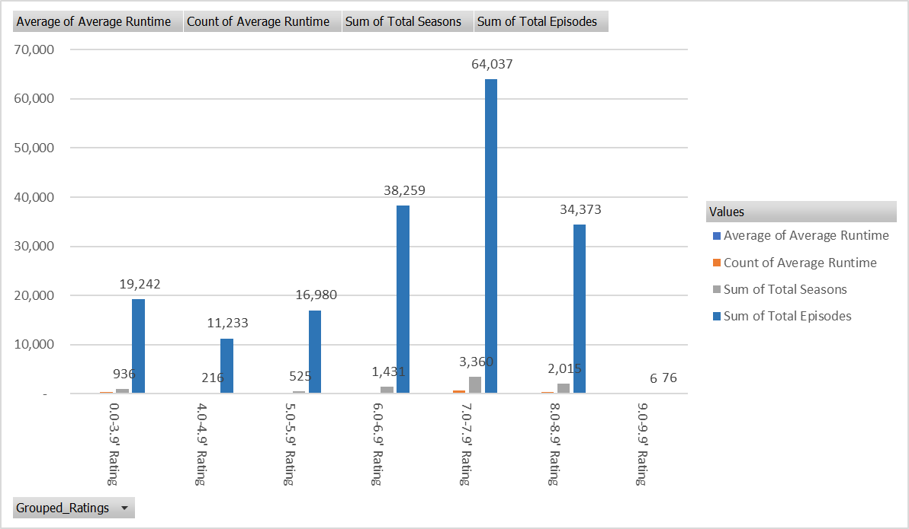
Question 5: Correlations between viewer ratings, run times, Season, and episodes
Key Findings:
1. There is a positive correlation between viewer ratings and average run times, with higher ratings corresponding to longer run times.
2. The average run time increases as the rating range increases, except the 9.0-9.9 rating range, which has a significantly higher average run time (62 minutes) despite having only 2 data points.
3. The count of average runtime and the sum of total seasons and episodes also increase as the rating range increases, indicating a strong correlation between these metrics and viewer ratings.
Insights:
- Longer run times are associated with higher viewer ratings, suggesting that audiences engage more with content that is longer and more in-depth.
- The strong correlation between average run time, total seasons, and total episodes suggests that these metrics are interconnected and influence viewer ratings.

Slide 15
Solution 5: Summary
Consider producing content with longer run times to potentially increase viewer ratings and engagement.
Develop content with more seasons and episodes to increase the overall average run time and potentially boost viewer ratings.
Analyze the 9.0-9.9 rating range further to understand the anomaly in average run time and its potential impact on viewer ratings.
The summary provides a snapshot of the correlations between viewer ratings and run times, highlighting key trends, insights, and recommendations for future content development

Slide 16

Summary

Slide 17
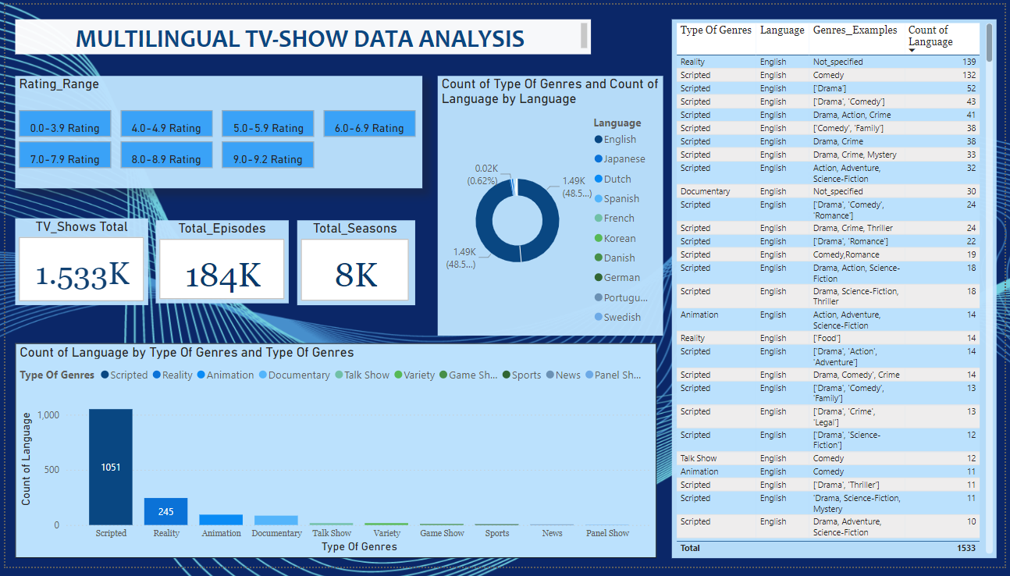
Summary
Key Takeaways:
Scripted and English-language content are key drivers of viewer engagement and ratings.
Longer run times and Reality TV shows offer opportunities for growth.
Diversification in other languages can attract niche audiences.
Action Plan:
Develop a slate of Scripted TV shows in English.
Explore Reality TV show concepts with longer run times.
Consider producing content in other languages to attract niche audiences.

Slide 18
Recommendation
To maximize viewer engagement and ratings, we recommend:
Develop more Scripted content: As the most popular genre, Scripted TV shows have the highest average viewer ratings and longest run times.
Produce English-language content: English-language TV shows dominate viewer ratings, with the highest average ratings and longest run times.
Create content with longer run times: Longer run times are associated with higher viewer ratings, suggesting audience engagement with more in-depth content.
Explore opportunities in Reality TV: Reality TV shows have a significant presence in high ratings and longer run times, making them a viable option
Diversify content in other languages: While English dominates, other languages have niche audiences, offering opportunities for growth and diversification

Slide 19

LinkedIn https://www.linkedin.com/in/eyitayo-sulaiman-mba-acti-fca-47bb9210/
X.com https://x.com/Seyitayo_FCA
Email tayosulaiman@gmail.com

